Slide 1
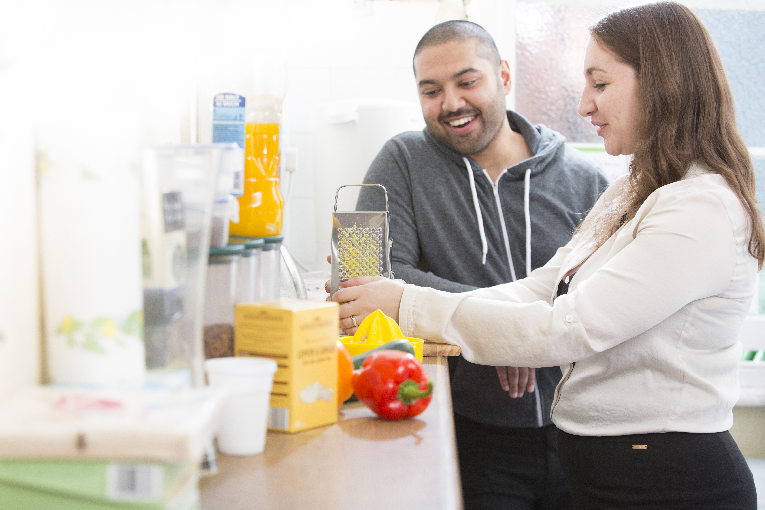
Resilient Together
Stories from 18 people from the communities of Wisbech and Southern Fringe

Slide 2
Acknowledgment
This project is funded by Cambridgeshire County Council. We would like to thank our Commissioners to invest in this innovative intervention.
We would like to thank all the residents, the organisations, the informal group and the local institutions that we have met and worked with along the journey of the project so far.
Especially, we would like to thank the residents that have engaged in the project as co-researchers and being involved in the different design phases. To them goes our gratitude as they have been so generous in sharing their knowledge, contacts and their passion for making their local communities a better and more connected place to live.
We would like to acknowledge that the images used in this report have been taken from Mind stock and from the Pexels website.
Cambridge, 1st April 2017

Slide 3
About this work
Resilient Together
Resilient Together is a three-year community building project focused in Wisbech and the Southern Fringe of Cambridge.
Overall Aim
Our overall aim is to improve wellbeing and resilience within these two communities by:
Building social connection – for instance we support residents who are passionate about their community or have similar interests/motivations to come together to make a change or take on a new project to help their community
Empowering residents to get involved in their community, by connecting them with others who share similar interests and/or motivations and by inviting them to share their skills and knowledge with one another
Raising awareness about wellbeing and mental health – We support community groups to develop activities around mental health and wellbeing to reduce stigma in their community
Community Need
Both Wisbech and the Southern Fringe of Cambridge are appropriate beneficiaries of a community building project since both areas experience relatively poor community cohesion which could be improved to the benefit of residents. The factors impacting the community cohesion varies between the sites. This offers us the opportunity to evaluate the scalability of our approach since working in demographically distinct areas allows us to test the efficacy of our model across different populations and infrastructures. Ultimately, we hope to be able to apply our approach to areas of need nationwide.
More about Our Communities
Wisbech has experienced a lot of change over the past few years, with a decline in its traditional industries and a rise in the agri-tech sector. There is an increasingly elderly population. A third of the population are economic migrants from Eastern Europe. Wisbech has a lower percentage of people ‘in employment’ at 62% than overall in the East of England (from ‘Wisbech Community Led Local Development Programme: Local Development Strategy’, August 2016). These factors have led to poor community cohesion and to many groups becoming marginalised.
Living somewhere where I feel I am welcomed and I know the people that live around, makes me feel safe… If you don’t know anyone and you don’t know where to turn if you need help, that is worrying me.”

Slide 4
The Southern Fringe of Cambridge is a new housing development which sits around the historical village of Trumpington in the south of the city. Approximately 2000 new homes are now complete with an estimated 4,800 new residents so far.
With new residents constantly moving in, the exact demographic figures are unknown but there is both a high proportion of young families due to the new schools and actively retired due to the proximity to Addenbrookes hospital. There is a large migrant population of diverse nationalities. 40% social housing is dispersed throughout the market houses. Social housing and private renting means a greater turnover of occupants.
Different population characteristics to the surrounding area may have delayed establishing a cohesive community. Furthermore, research into new communities has established clear links between loneliness, poor mental health and antisocial behaviours, with a lack of community cohesion and social networks.
Engaging with people from the communities
We believe that the most qualified people to design a new intervention to build and maintain resilience in the local communities are the people that will benefit from it - those that live and work and see themselves as part of that community. To that end, we worked together with people from the two communities of Wisbech and the Southern Fringe area, and experts from the field, in order to collaboratively design this Resilient Together Model.
During the first year of the Resilient Together Project Mind in Cambridgeshire has engaged with 361 people from the two Communities of Wisbech and the Southern Fringe of Cambridge. Staff from the project have been out and about in the communities talking to residents, meeting groups, mapping the people’s skills and the assets available and supporting everyone who wanted to do more to be active in their communities.
An Asset Based Community Development Approach
Our community building project uses an Asset Based Approach (also ABCD) which means that we aim to bring people and communities together to achieve positive change using their existing knowledge, skills and lived-experience, around the issues they encounter in their own lives and that they care about most.
Asset based approaches recognise and build on a combination of the human, social and physical capital that exists within local communities. They acknowledge and build on what people value most and can help ensure that public services are provided where and how they are needed.
An ABCD approach also enhances the protective factors which help individuals and communities maintain and improve their mental health, even when faced with adverse life circumstances.

Slide 5
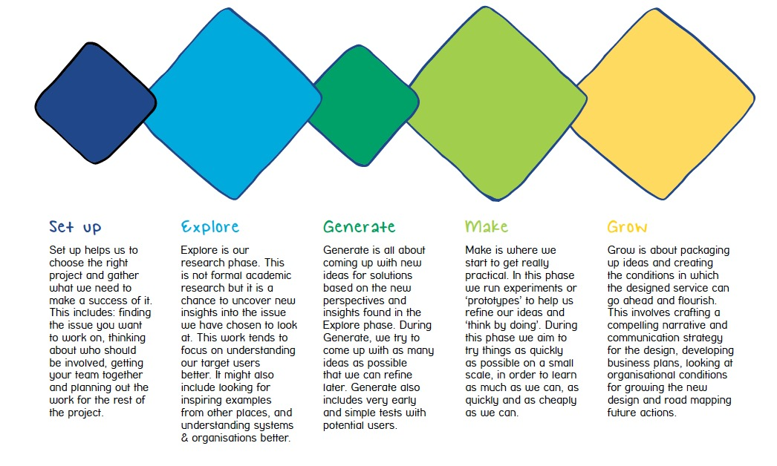
Service Design
Using a Service design approach
This work has been realised following the principles and the steps of the Mind Service Design methodology. “Service Design in Mind” is an innovative approach, developed and tested by Mind nationally together with local Minds and people with lived experience of mental health, working collaboratively to design new services or improve existing ones.
Working in collaboration with the Mind ‘Service Design’ team, we at Mind in Cambridgeshire are embedding design approaches and skills that help us to to create innovative, desirable and effective offers. Service Design helps us to uncover new insights and understand our target users better, to test new ideas in order to refine them, to engage with partners and people with lived experience in new and more meaningful ways.
We think the Service Design in Mind offers an ideal approach to address the design of a complex project, like the Resilient Together project, and engage meaningfully with all the different stakeholders, including residents of the local communities.
The Service Design Methodology is a structured approach made of 5 key steps:
Set-Up This stage of the methodology is focused on establishing strong foundations on which to build a project
Explore In this stage, Mind uses design methods and tools to uncover real experiences, issues and needs from a small sample of key stakeholders
Generate This step of the methodology is about identifying a direction and different ways of achieving that through creative methods and tools
Make This stage focuses on prototyping ideas to make changes and improvements before finalising the service design
Grow This stage focuses on finalising an idea and packaging it in a way that means it can be commissioned and delivered

Slide 6
This report
This report describes the findings from the ‘Explore’ stage of the Service Design Methodology, where our team and a group of co-researchers from the community undertook research to uncover new insights into what motivates local communities to be active and develop and maintain resilience.
It describes the key themes and patterns that have emerged from what the people we interviewed told us. In particular we heard what motivates people to act, what is important to them, what are the barriers they experience in being active in the community, the type of support they value, what needs to be improved and the gaps in the current provision of services and support.
Service design is valuable because it offers us the chance to move from choosing between alternatives, to building completely new ideas. Service design enables us to be radical, visionary and lead the way forward with innovative ideas and practices. Evidence-based practice is a good thing, but if we are limited to solutions that already have an evidence base we can never do anything new. Yet we know that we don’t have all the solutions right now, and so service design gives us a way of confidently exploring new possibilities, generating new evidence along the way. This is the heart of service design; by working in a systematic way we can create new services that are radically different, whilst having high confidence that they will work.
We have included some quotes below to give an overview how our participants feel about their communities and how much being active and connected to others is important to nurture their sense of identity and of belonging and also to illustrate what the problems and the barriers are for people:
“Many people don’t know where or how to get help in their neighbourhood and this is wrong”
  “People talking to each other, that’s what’s missing”
“People under the age of 25 are not seen much around here, there is nothing to encourage young people to have a positive outlook”
“Have found it hard to meet with people locally, because they seem to have very specific groups … It’s all people over the age of 25 … there are no LGBT groups”
“I only moved here recently. It has amazing potential in this area. I want to be an entrepreneur so for me it’s amazing. Cost of living is low. My sister is setting up a business. It’s amazing for things like that”
“(…) my biggest problem is transport. There are times when I want to do something (..) but I cant do that, because there are no buses.”

Slide 7
Who we spoke to
During the 4 weeks of the Explore phase, that went from November to December, we talked with 18 people from the two community areas to understand more about their lives, the things that are important to them, and their sense of living in a community. We also recruited 5 people from both Wisbech and the Southern Fringe area to work with us as co-researchers in the community. These people were trained and supported to go out and talk to their neighbors about their dreams, their needs and assets. These co-researches were also involved in the analysis of these conversations and the idea generation phase.
A summary of the research participants that we spoke to is provided below. Further details are available overleaf on page 6.
Sampling
  In our sampling we were looking to represent both the locations and for our sampling to be quite representative of the demographic in the two local areas:
  Wisbech:
      Women and Men from the local area
      People from the Eastern European Community (both men and women)
      Young people living in the area
  Southern Fringe:
  Men and women from the local area
  Older people that live locally
  People from diverse communities
How many people we spoke with | 18 people in 1 to 1 in depth interviews
From what boroughs they were coming from? | The explore phase reached the two Boroughs of Wisbech and Southern Fringe
How many women and men? | We reached more women than men (13 women and 5 men)
Age group | We reached quite a diverse age group, with people from 20+ to 60+ years old

Slide 8
Wisbech area
Name*: | Age: | Lives in | Ethnicity
A (Female) | 21 | Wisbech | Polish, Israeli, English
B (Male) | 28 | Wisbech | Romanian
C (Female) | 50-60 | Wisbech | White British
H (Female) | 45 | Wisbech | Asian
I (Female) | 52 | Wisbech | Lithuanian
J (Female) | 36 | Wisbech | Russian
K (Female) | 54 | Wisbech | Lithuanian
R (Female) | 50-60 | Wisbech | White British
Trumpington Area
Name*: | Age: | Lives in | Ethnicity
D (Male) | 55 | Trumpington | Korean
E (Male) | 41 | Trumpington | Irish/British
F (Male) | 46 | Trumpington | Italian
G (Female) | Late 20’s | Trumpington | White British
L (Female) | 25 | Trumpington | White British
M (Female) | 30 | Trumpington | Polish
N (Male) | 62-67 | Trumpington | White British
O (Female) | 82 | Trumpington | Irish
P (Female) | Early/mid-30’s | Trumpington | Jamaican
Q (Female) | 69 | Trumpington | White British

Slide 9
Personas
The following section of this report presents four personas.
A persona is a fictionalised introduction to a person, containing insights and information based on real people and their experiences. The four personas included here are an amalgamation of the experiences of the participants involved in this research, reworked to remove individually identifiable information. They present in a meaningful way some of the most common experiences and feelings that were shared with us during our interviews.
Personas are very useful service design tools that enable the capture of key characteristics of different people in order to design around their needs. Personas are succinct, portable and useful in engaging others that were not involved in the research, by bringing findings to life and making them relatable. For instance, personas are very useful to engage with stakeholders to demonstrate the value of a service through telling the story of the people that were interviewed and the people that will be using that service.
Personas are very useful tools throughout the design process and we will be using them again, for instance, for developing possible pathways and user journeys into the service, to test new service ideas, communicate our project externally and to ensure that we always keep the process strongly person-centered.
So turn the page to meet our four residents from Wisbech and the Southern Fringe area.

Slide 10
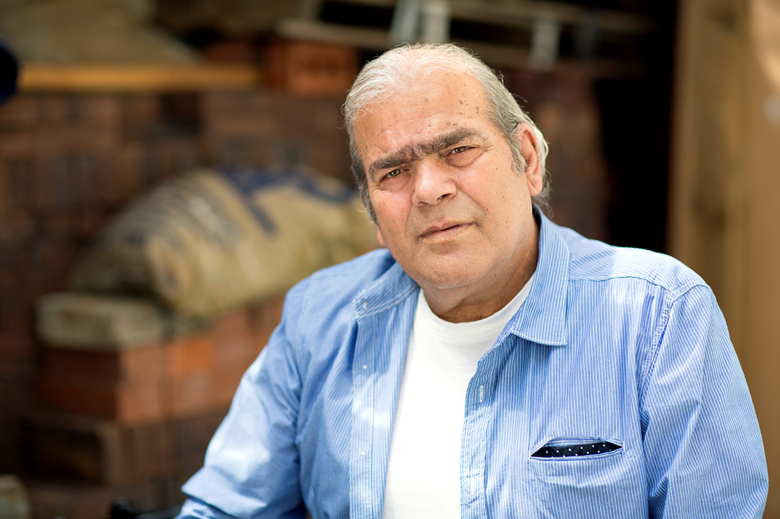
.
Neil’s story
AGE: 58
Southern Fringe of Cambridge
Key quotes:
“I am much happier here than I was in my country”
His story
Key needs
Neil was born in Romania and grew up in Italy. He is a teacher and initially moved to Wales where he was teaching in a primary school. He married twice and is now a widow.
He is usually very busy from work and comes back home after 4.30pm everyday during the week. As he has no children, his circle of friends are some colleagues from school, whom he sees only during the week, and the people that go to the local Church.
He moved to Southern Fringe of Cambridge in 2014 and since then he has been living there. Neil likes the Southern Fringe of Cambridge but he thinks the local community is not very cohesive and connected in the area. He used to promote events and organised a local Christmas party once, but as people did not engage he was really disappointed and has stopped doing that now.
As he is growing older this also has had an impact on his social life and he is now less active in the community.
He has financial worries as he is growing older and reaching the age of retirement
Sometimes he needs some specialist help to look after his mental health as he suffers from depression
As he has some initial symptoms of MS he is increasingly less mobile
Social Network
His social life is not very intense and most of the closest people he knows and can count on are members of his family that live in Italy or Romania.
The Church is a very important place for Neil, as this is where he spends most of his weekends and he is also learning to play the organ.

Slide 11

.
Carolin’s story
AGE: 41
Southern Fringe of Cambridge
Key quote:
“I don’t have the people to meet that are similar minded and to socialise with. It doesn’t exist here”
Her story
Key needs
Carolin come to the UK when she was fourteen years old. She married when she was still very young. She moved to the Southern Fringe of Cambridge in 2015.
She loves the Southern Fringe of Cambridge area, the environment and the community, as this is a developing area, not too far from the town but also very quite.
She has four kids that keep her very busy.
She also owns a restaurant and she does lots of activities that are linked to her country of origin. For instance she is collecting funds to donate once a year to the local schools in her Country to support children’s education. She loves helping others when she can and she is very active in her local Church as she finds it a community that support each other. This is all part of the way she was brought up when she was in her Country and she wants to keep the traditions strong.
Her family and her children are for her the most important thing.
To meet others from her ethnic community
People to trust in the Southern Fringe of Cambridge.
Stay in touch with her mum in her Country as she helps her calm down when things are not good
Don’t get too busy and manage her stress so she can sleep well at night
Social network
Carolin had some unpleasant experiences in the local community as she felt betrayed by local people and now struggles to re-establish trust.
She is very active both in the local Community and in her Country of origin.
The local Church is also very important to her.

Slide 12
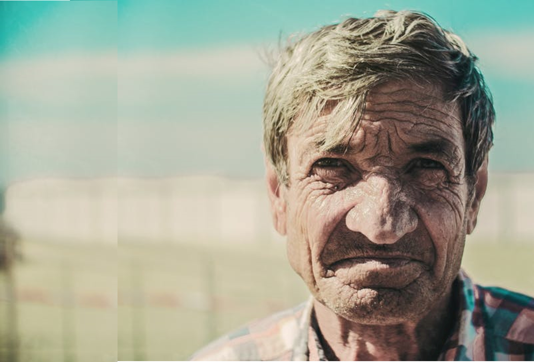
.
Roger’s Story
AGE: 64
Wisbech Area
Key quote:
“It colours your world when people are nice to you. Community gives you purpose and meaning which is really good for your mental health”
Stock picture courtesy of www.pexels.com
His story
Key needs
One of 6 children, Roger was born in Ireland and when he was still very young he met and married his wife.
They have been together for 50 years and recently moved to Wisbech to be near the family, after his wife suffered a heart attack.
Roger I now s a carer for his wife but always finds the time to do several activities: he teaches English to local residents, which has ‘opened his eyes’ to the traditions and special occasions of others; he volunteers at the museum, running creative writing workshops; he also helps at the local school, in the nursery, helping children with their reading.
Having services close by – hospital and supermarket – or buses to travel to places
Somewhere to chat over tea or coffee – a community centre, or at the church
A sense of community where people help one another
Funding to keep the museum open
Social network
Roger regularly attends a local club, but this is out of town
His family is very important to him, particularly his wife and daughter and his son, who lives out of town
His ‘museum friends’ and half a dozen close friends in the local area are his social network

Slide 13
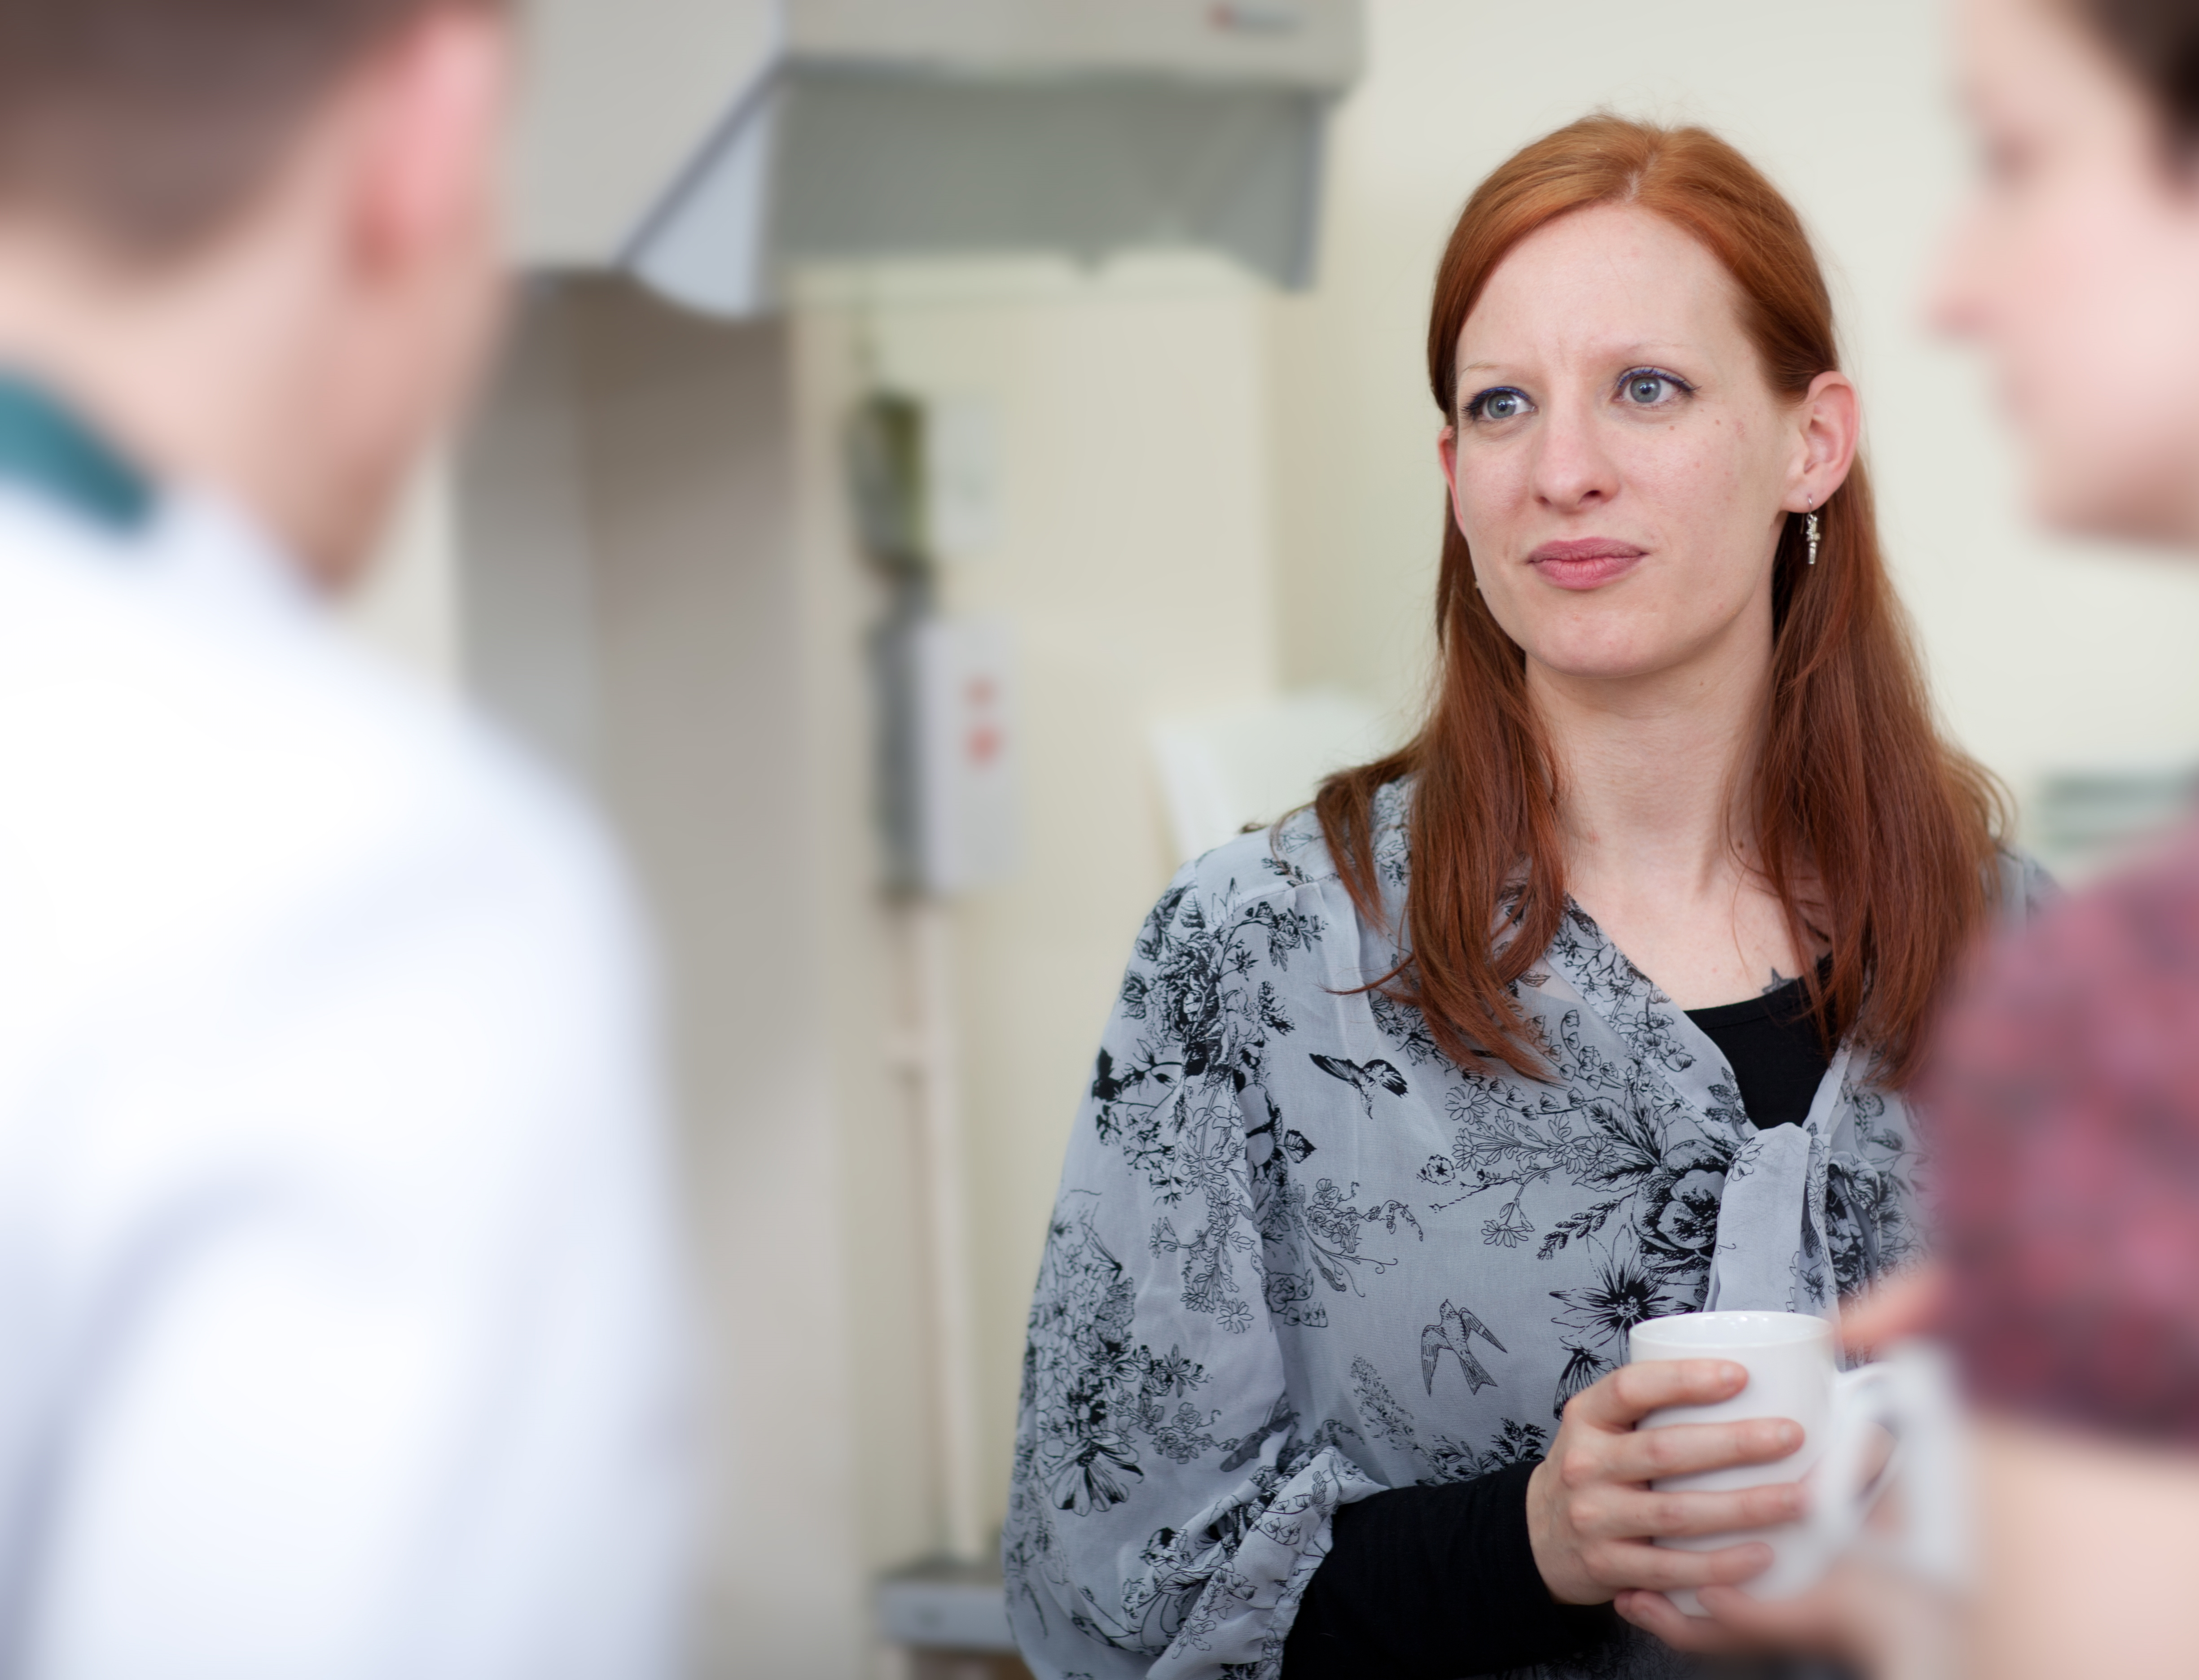
.
Miriam’s Story
AGE: 28
Wisbech area
Key quote:
“Once you realise you’re not on your own, it’s easier to get out and talk to people.”
Her story
Key needs
When she was younger Miriam worked in theatre and as a model. Before, she lived with her husband and son, but when her marriage broke down she moved to Wisbech (almost 2 years ago).
She is dyslexic and suffers with depression, but is a talented artist, who now runs a craft shop.
She has previously run several community art projects with a particular interest in folk tales and the environment She is now running a group that combines arts and working with children. Despite issues with funding she continues to promote this group which she sees as an essential service to the local community.
More recently she put on a Macmillan coffee morning which helped to bring people together and raise money for a great cause.
A safe community for her son to grow up in
More funding and some extra help to make sure the local groups she run are sustainable in the long term
A support network of trusted people she can talk to
Opportunities for learning – first aid, maths, English
She is also looking for a job and doing as much as she can to gain experience to get a good one.
Social network
Miriam loves being busy and finds her work in the arts and children group very rewarding. She also spends time with elderly people, providing company for them.
Most of her network comes from the groups that she runs and her artistic activities.
She is in touch regularly with other mum’s that she has met through the school.
She also has friends back home that she can call

Slide 14
The findings at a glance
Our brief when we started our exploratory phase was to understand a bit more about how we could support residents to engage in meaningful activity that contributes to their community.
We wanted to know more about what motivates people in their life to be active and to give; what barriers they come up against and what support would be most helpful in encouraging them to do more and sustain their motivation in the long-term.
Below is an overview of some of the key findings that we collected from the interviews with members of the community in Wisbech and the Southern Fringe. The findings are organised into ‘Themes’.
A ‘theme’ is a pattern, something that people say that is common and shared by many others. A theme could also be something revelatory, unexpected and which could be applied to other people as well.
In identifying the themes, we also drew on the local knowledge of our co-researchers.
The four themes that we identified are:
1. What motivates people
2. Feeling safe
3. The Barriers
4. Participation as something you can learn
For each theme, we explore a bit more about what the unmet needs are, what the assets are and we start to move towards possible solutions.
The solutions section - What Could Work - came out of two community workshops that were organised in January and February in the respective areas. The Workshops followed the World Café style and saw different people (including residents, community workers and civil servants) discussing and building on each other ideas.

Slide 15
Theme 1 - What motivates people
THEME | THE NEEDS and THE ASSETS | WHAT COULD WORK
I want to improve my life and my community People in Wisbech and Southern Fringe want to make their lives better; the community space and what this has to offer has a key role to play | People wanted a good balance between a rich community and a rich personal life People chose where to move and want a vibrant place to live where there is sense of community Some people look for people like them to develop bonds and relationships A strong community can help you when you need it (e.g. practically someone could lend you what you need or at least you have somebody to ask) Sharing is an important part of what motivates people: they do things because they want to share what they know, what they can do or their passions The people that do more in the community tends to be the ones that have strong personal motivations and clear priorities to do more for themselves and their loved ones: Learning and Education is an important part of these people’s lives | Local Talks & Walks: Having different street-led events to get people to know each other and to know more about their neighbourhood Champions: someone who can spread the message of welcome and start a conversation with new people in the area (this could be linked to sharing experience and skills) Celebrate different cultures: we could have informal places (like cafes) where people can learn about a different language, food, culture and from people from different generations (e.g. Human Library type events) Online and off-line ways to broadcast community news and events (open days or using local history might be a nice way to get to engage people in the community where they live)

Slide 16
Theme 2 – Feeling safe
THEME | THE NEEDS and THE ASSETS | WHAT COULD WORK
A strong community makes me feel safe Where there is an open and welcoming community, people feel safer | New people that moved to one of the two areas felt immediately that the place was not welcoming Bad reputation of a place contributed to stereotypes and people’s attitude towards the area was affected in a negative way Young people felt that there was no dedicated space for them to enjoy passing the time, only places to ‘do things’ (e.g. the gym or a pub) Between old and young residents there can be barriers that prevent people from understanding each other A sense of purpose, a social network and personal contacts were really important to people to help them feel positive, calm down from anxiety and feel in control Some people said that if they were ill they would not know where to turn for help, and this was worrying them | Reclaiming the Streets Online private 24-hour support and networking opportunities Local Network of friends and neighbours to help you feel safe: e.g. text a neighbour to let them know you’re home safely Build Inclusive community that consider differences: Autism-friendly shopping hour (e.g. no music between 10-11am) or Men’s Safe Space (like LGBT, shouldn’t be limited)

Slide 17
Theme 3 – The barriers
THEME | THE NEEDS and THE ASSETS | WHAT COULD WORK
Sometimes barriers to do things are not physical or external but in our heads Several barriers make it difficult for people that want to, to give and do things in their communities | Lack of coordination means that available activities are sometimes at the wrong place and at the wrong time Some people need to take small steps to feel confident to engage in their communities. People felt that some of the official places to engage in community activities were artificial and that they preferred, for instance, the familiarity of a local cafe If people were new to an area they didn’t know what resources were available and just getting to know this could take a lot of time Lack of local transport can be a huge physical barrier for people to participate in their communities Not speaking good English is a barrier to participate and get to know people and places | Providing support to starting up new activities in the community: using time-credits and having paid opportunities people can be motivated to facilitate new activities Develop A Community Local Asset Map: to ensure all resources are mapped and there is better signposting and sharing of where resources are (venues, skills, people, funding, etc.) Lift sharing scheme – in addition to the provider-led Community Car Scheme delivered by the Care Network in Wisbech (http://www.fenland.gov.uk > Transport > Community Transport) a resident-led lift-sharing scheme could help address some of the transport needs in Wisbech.

Slide 18
Theme 4 – Participation is something you can learn
THEME | THE NEEDS and THE ASSETS | WHAT COULD WORK
The hardest thing to learn is to let people helping you Some people felt that the way they behaved and were active in their community was linked to their upbringing | People said that they learned about the importance of giving from their education when they were kids People thought that everyone could do more if they are given a fair chance to do so Some people told us that they felt happy to take part if something was being organised in the community but didn’t feel strong enough to take the risk to organise something themselves for fear of failing People that give more, find it difficult to ask for things themselves People felt that sometimes being the only one ‘giving’ all the time can be tiring - they wanted others to be active too, so they could take a break (e.g. organise a rota) Some people need others to help them realise that what they do is valuable and that they have amazing skills to use Some people felt that it took them a while to build trust with strangers. They were approachable themselves but didn’t feel comfortable enough to get close to other people | Supporting volunteering as a model for self-confidence: People can come up with their own volunteer spec and decide what their role should look like in the community and have a stake in the activity Mentor/buddy scheme: Opportunities to meet others in Non-threatening and non-judgemental comfortable settings Schools giving opportunities: where key people from the community (GPs, teachers, shop-owners) and residents will be sharing their experience Expand the scope of Love Your Home (DIY, decorating and design on a budget – make and take home existing event) to other parts of Wisbech

Slide 19
Horizon Scanning
Horizon scanning is a process of researching organisations or services that have something you are interested in and from which you can learn. It might be that they are very effective at working in the same field as you. It might be that they work in a completely different field, but that they exemplify some principle that you would like to explore.
For example, a designer working on a project to help isolated people with mental health issues to be more connected to the communities around them, might look at dating sites as part of their horizon scanning because they know these people are expert at managing introductions and trust in an online environment.
In our project at Mind in Cambridgeshire we looked at different examples to learn about the following things:
What are the different ways to ‘activate’ a community?
How can we build a culture of participation and community engagement?
What is the role of community builders in this process?
What types of ‘communities’ (e.g. issues based, place based, etc) are out there and how are they different?
In the following pages we present some of the most inspiring examples that we have been looking at and we are now planning sites visits and telephone interviews with these organisations and groups to learn more about their initiatives directly from them.
During the Design process, Horizon scans will be used to inspire us when we will move to develop and design new service ideas, but also to make sure that we build from what works and we don’t reinvent the wheel.

Slide 20
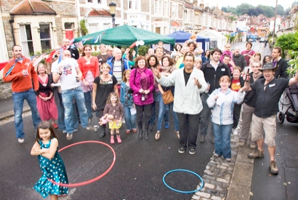
Streets Alive
What is it? And what does it do?
It’s a national neighbours and street party charity founded in 2001. It makes it easier to hold street parties across the UK with advice on, for example, road closures, and free resources. It has helped Bristol to become the Street Party Capital of the UK, with 100+ events held annually. Such events build community from the ground up, giving residents a reason to meet:
Street Parties: They are an effective and fun Street Mixer to meet neighbours. Organised and funded as private events by and for residents, the road is closed for the day to make way for bunting, chairs, games, food and a lot of chat.
Other Street Mixers: without closing a road residents use whatever space is available - pavements, gardens, drive-ways, local pub or front room.
Street Picnic: residents meet up in a local park for a shared picnic.
Street Facebook: a dedicated page which the street is invited to join to organise face-to-face Mixers and to share information.
Street Welcome: a new resident can be a good excuse for meeting neighbours, inviting in for tea, or given a gift or welcomed by a signed card from neighbours.
Street Lounge: not requiring formally closing a road, carefully parked cars and carpets can be used to slow and alert traffic, and chairs on the pavement.
How it works and how is it funded?
Once engaged and trust is built with their neighbours and the community after Meet my street events we invite residents to Activate My Street through:
residents organising social, cultural, sporting, and environmental activities;
signposting people to support and advice services;
recruiting volunteers for voluntary groups and charities;
engaging people with public consultations and the more formal political system.
It also runs the streetparty.org.uk website.
Streets Alive is a not-for-profit limited company with volunteer Trustees and it gets funding from Foundations and small Community Grants
What does it achieve?
Promoting neighbourliness for community development
Supporting a programme of street parties for community cohesion
Working in a diverse estate
Recruiting residents to join in restorative approach to antisocial behaviour
Encouraging residents' to increase local participation and build up skills and confidence in the run-up to a larger community festival
Streamlining local authority procedures

Slide 21
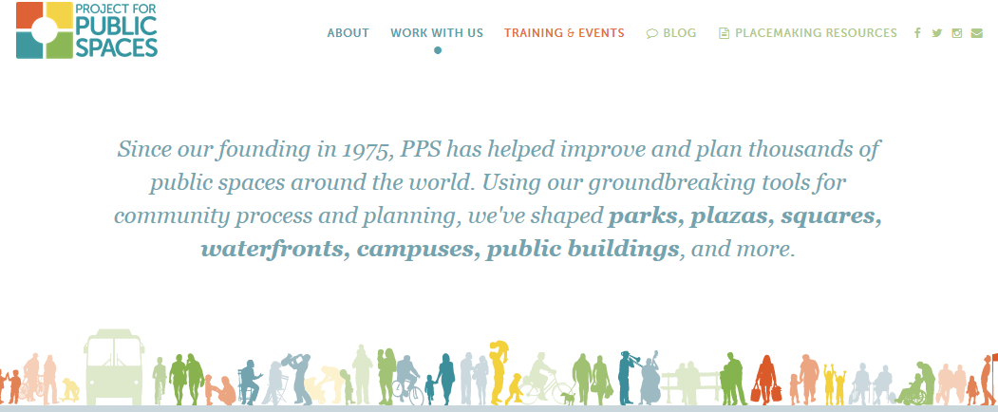
PlaceMaking
What is it? And what does it do?
Placemaking inspires people to collectively reimagine and reinvent public spaces as the heart of every community. Strengthening the connection between people and the places they share.
Placemaking refers to a collaborative process by which we can shape our public realm in order to maximize shared value. More than just promoting better urban design, Placemaking facilitates creative patterns of use, paying particular attention to the physical, cultural, and social identities that define a place and support its ongoing evolution.
With community-based participation at its center, an effective Placemaking process capitalises on a local community’s assets, inspiration, and potential, and it results in the creation of quality public spaces that contribute to people’s health, happiness, and well being.
Placemaking is a crucial and deeply-valued process for those who feel intimately connected to the places in their lives. Placemaking shows people just how powerful their collective vision can be. It helps them to re-imagine everyday spaces, and to see anew the potential of parks, downtowns, waterfronts, plazas, neighbourhoods, streets, markets, campuses and public buildings.
For more information: http://www.pps.org/
How it works and how is funded?
Project for Public Spaces (PPS) is a non-profit planning, design and educational organisation dedicated to helping people create and sustain public spaces that build stronger communities. Our pioneering Placemaking approach helps citizens transform their public spaces into vital places that highlight local assets, spur rejuvenation and serve common needs.
Placemaking is inspired by some key principles
The Community Is The Expert
You Can See a Lot Just By Observing
Have a Vision
They Always Say “It Can’t Be Done”
Money Is Not the Issue
You Are Never Finished
(see more here http://www.pps.org/reference/11steps/)
What does it achieve?
PS was founded in 1975 to expand on the work of William (Holly) Whyte, author of The Social Life of Small Urban Spaces. It has since completed projects in more than 3000 communities in 43 countries and all 50 U.S. states and are the premier centre for best practices, information and resources on placemaking. More than 900 people worldwide are members of our Placemaking Leadership Council.

Slide 22
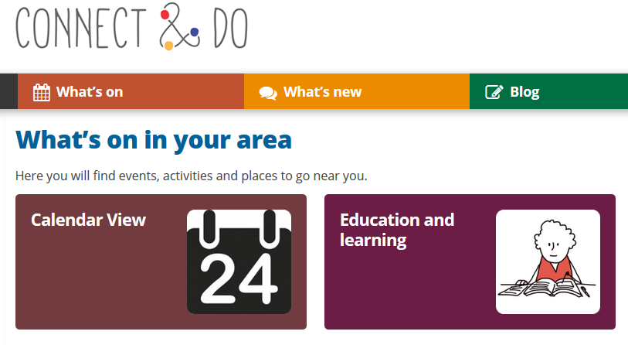
Connect & Do
What is it? And what does it do?
Connect & Do helps you build friendships around shared interests in your local area, by making the most of opportunities available near you.
Connect & Do is a social networking site, where you can find groups and events in your local area, join in to create your own profile, meet new people, share ideas, set up your own groups, and help other local people or groups near you.
Connectanddo.org is an online community movement which allows users to get recommendations of courses and activities that they can do based on their interests. It trains volunteer supporters to help people get involved with opportunities that they like the look of, such as football, painting or learning a language, and meet people with similar interests to theirs.
It also has a function which allows people to set personal goals and track their moods and progress. People can also create new groups if one catering for their interests doesn’t already exist.
To read more: http://www.connectanddo.org/
How it works and how is it funded?
People with mental health problems and learning disabilities often have low confidence and are socially isolated; and heavy interventions can't always best support them to become more confident and independent.
Certitude, a charity which offers a range of services for people with mental health issues and learning disabilities across London boroughs, recognised that there is a wealth of unused potential within communities. They figured that patients already see enough of mental health services and clinicians, and wanted to develop an initiative that focused on building people’s confidence, reducing social isolation and getting out into the community.
Working with the a design agency and with sponsorship from the Lambeth Living Well Collaborative; Certitude’s aims were to design an approach that would make communities more accessible, and could modernise and transform the day services for people with mental health issues and learning disabilities.
What does it achieve?
The aim of the club is to build a supportive community movement which helps people with low confidence to get more involved in the things they love doing.

Slide 23
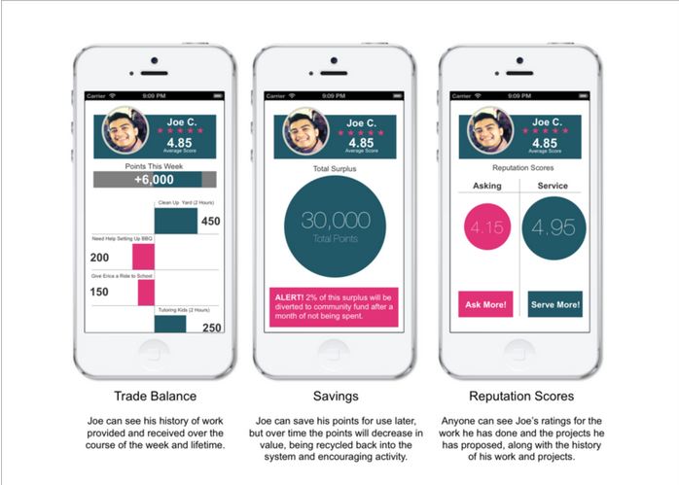
Community Coin
What is it? And what does it do?
What can we do to reward people for creating value and providing needed services in their communities, even if the people they help cannot pay them in institutionally-approved currencies? How can we unleash latent work and human potential to solve the biggest unaddressed issues facing our communities worldwide? How can we empower individuals with plenty of value and creativity to add, but who have been failed by traditional market arrangements?
Community Coin benefits those who are willing and able to work, create, and serve others, but who individually or as a community, do not have adequate access to currency supplied by financial institutions, or the resources that this institutional currency provides.
This idea empowers communities to reward work, service, and creation of value without reliance on external institutions. The latent and unrealised work and value-creation capacity of communities due to the inability of actors within the community to pay for work or value-creation with institutional currency is immense. By empowering the community to reward work and value creation independently, that latent potential can be unleashed to improve the community.
To read more: https://challenges.openideo.com/challenge/financial-empowerment-challenge/top-ideas/value-creation-and-service-economy-with-reputation-as-currency
How it works and how is it funded?
This idea is based on providing an online and mobile app platform (for smartphones as well as basic SMS cell phones) to recognize and reward the work or services provided by others, and allow these rewards to be meaningful for the exchange of goods and services between individuals. Currency can be created, distributed, and managed in several ways:
1. People can earn credits from each other via a mutual credit system, which can be exchanged for goods and services indirectly, or they can earn unlimited points, which can be exchanged for virtual goods (such as badges and online currencies, much like video game points). This subtle difference allows greater variety of value-creation to be rewarded and encourages initiative.
2. Any person can submit a need that others can respond to. By helping to meet the need, the person gets credits for their work.
3. Any person can propose service or work, and others can accept the service or work, and once complete, validate their service, thereby creating credits for the worker.
What does it achieve?
By formalizing and legitimising (in economic terms) the independent exchange of value-creation, and giving every person the opportunity every day to initiate value creation (by allocating potential credits instead or reallocating currency), work or service that is otherwise not included in the formal economy now gets recognised and rewarded.

Slide 24
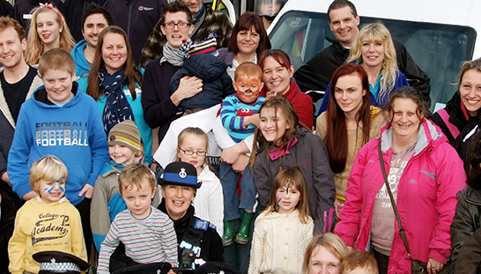
C2 Connecting Communities
What is it? And what does it do?
C2 originated from the work of two health visitors, Hazel Stuteley, C2 founder, and Philip Trenoweth, on the Beacon estate in Falmouth in the 1990s.
As a response to coping with an impossibly demanding case-load they introduced a community-led intervention that reversed the decline of a heavily stigmatized estate of 6000 people. The Beacon project became a national flagship for resident-led community renewal and health improvement.
The method used was consolidated in a further intervention in 2004, formulated into a replicable framework of 7 practical steps, following two years’ further analysis by researchers from the Health Complexity Group at the University of Exeter Medical School.
Described as community health creation*, C2 works by releasing the latent strengths of residents and service providers, to work together as equals to jointly problem solve & improve local conditions. This is highly cost effective and leads to lasting community resilience & self-organisation.
*Health creation is the enhancement in health & wellbeing that occurs when individuals & communities achieve a sense of mastery & control over their own lives & immediate environment”.
To read more: http://www.c2connectingcommunities.co.uk/
How it works and how is funded?
The C2 model has 7 steps:
Step 1 Establish Strategic Steering Group (SSG); Key residents assist in assessment of baseline community connectivity, hope & aspiration
Step 2 Establish Partnership Steering Group (PSG) of front-line service providers and key residents with common interest in improving the neighbourhood; Identify 6-8 members to attend C2 Introductory Learning Programme
Step 3 Host Listening Event to identify and prioritise neighbourhood health & well-being issues; ‘People and services’ commit to jointly tackle issues
Step 4 Open clear communication channels to the wider community via e.g. newsletter and neighbourhood ‘walkabouts’; Exchange information with other local community groups/strategic organisations; Identify ‘2nd wave’ of 6-8 new learners to C2 Experiential Learning Programme
Step 5 Monthly PSG meetings celebrate the ‘wins’ to increase community confidence, volunteering and momentum towards change Steps 6 and 7 are about increasing community trust, co-operation, co-production and local problem solving to the point where key resident/s are employed and funded to co-ordinate activities.
In 2011 the NHS Institute for Innovation and Improvement sponsored C2.
What does it achieve?
Measurable outcomes and evidence of visible transformational change: new play spaces, improved residents’ gardens and reduction in anti social behaviours, all leading to measurable health improvement and parallel gains for other public services.

Slide 25
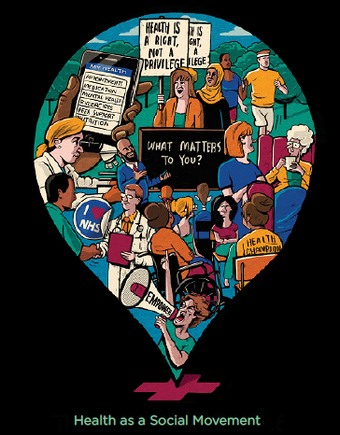
Health as a social Movement
What is it? And what does it do?
Health as a Social Movement is a new three year programme, to support social movements in health and care. Dramatic social change has been driven time and again by groups of ‘thoughtful, committed citizens’ coming together to change the world. People have come together to fight for rights, solve problems, shift how people think, support each other and demand what they need throughout history. It is important that we remember, indeed honour, the movements that have preceded us.
In their purest form movements are messy, vibrant, spontaneous and uncontrollable. They bubble up outside of formal institutions and from beyond established power structures. They challenge and disrupt. They are restless and determined. They often make society, elites and institutions deeply uncomfortable as they challenge accepted values, priorities and procedures.
Which is why it is extraordinary, and potentially unprecedented, for the leader of a major public institution like the NHS - a system that is understandably highly controlled, with clear hierarchies, rules and protocols - to actively call for more social movements.
As this programme explores, social movements in health represent a huge opportunity to think differently about how to develop and support health and wellbeing. There is the potential to combine the energy and dynamism of movements with the need for radical institutional change.
To read more: https://www.england.nhs.uk/ourwork/new-care-models/vanguards/empowering/social-movement/
How it works and how is funded?
Tip 1: Understand your own self-interest
Understanding our own motivation to act is key. We cannot develop effective action with others without knowing why we want to act and being able to articulate that in a way that others can understand. Building a social movement is inherently uncertain, and we need an emotional basis on which to ask others to step into that uncertainty with us.
Tip 2: Re-frame uncertainty as an opportunity
Social movement leadership requires us to accept responsibility for enabling others to achieve shared purpose in the face of uncertainty. In order to build the trust which allows us to do that, we need to calibrate our own mindset towards the opportunities within change.
Tip 3: Forget perfection. Embrace reality
There is no such thing as the ideal moment to start. Indeed, the whole point of organising social movements is that they are dynamic, people-led and therefore constantly evolving to the demands of circumstances in real time. Starting to organise a social movement means embracing strategy as a verb not a noun. It is something we do, not something we have, and it can only be improved through doing.
This programme is funded by the NHS
What does it achieve?
Identify and develop exemplar social movements– creating real-world examples of communities mobilised for health and care
Demonstrate ‘what works’– using rigorous evaluation approaches
Support spread – enabling local areas to develop approaches that could be scaled or adapted and adopted in other communities.

Slide 26

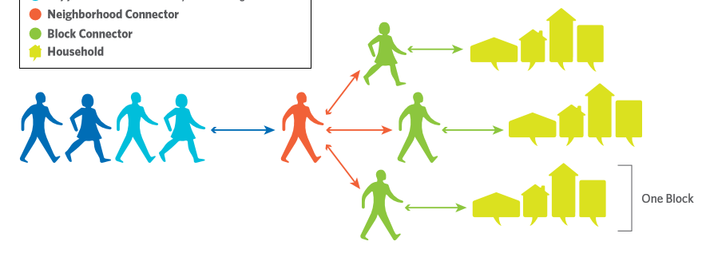
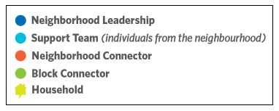
Abundant Community Edmonton
What is it? What does it do?
Neighbourhood connections aren’t as strong as they used to be – people often keep themselves to themselves. Abundant Communities Edmonton (ACE) is challenging that and helping to create a culture of care and belonging.
ACE is a framework that promotes community engagement and organization one neighbourly conversation at a time.
The Neighbourhood Leadership and Support Team are passionate about community engagement. They hire the Neighbourhood Connector and divide the neighbourhood into ‘blocks’. The Neighbourhood Connector is a community member who has the role (a part-time paid position) of identifying, mobilizing and supporting the Block Connectors. Block Connectors are outgoing, community-minded residents who initiate conversations with their neighbours to talk about their vision for the neighbourhood, mutual interests, activities they would like to engage in, and the skills, abilities and experiences that they could share. They encourage residents to meet their neighbours, act as a point of contact, and organise street parties and other social activities.
ACE brings people together in a way that might not happen naturally anymore.
How does it work and how is it funded?
Inspired by the philosophies of John McKnight and Peter Block as described in their book, The Abundant Community (2012), and an iteration of Asset-Based Community Development, ACE is a bottom-up community building approach based in Edmonton, Canada.
It is supported by the City of Edmonton Council and the Edmonton Federation of Community Leagues (efcl.org) and is a collaboration with the ABCD Institute.
For more information: www.Edmonton.ca/abundantcommunity
What does it achieve?
Enhances connection and belonging
Shapes neighbourhood life according to residents’ vision
Builds neighbourhood identity and pride through shared ownership/responsibility
Links residents to neighbourhood groups, existing and newly formed
Fosters an environment of care for one another by linking the skills, abilities and experiences of all residents
Reduces social isolation
Increases safety in the neighbourhood
Builds the capacity of the neighbourhood to engage with the council

Slide 27
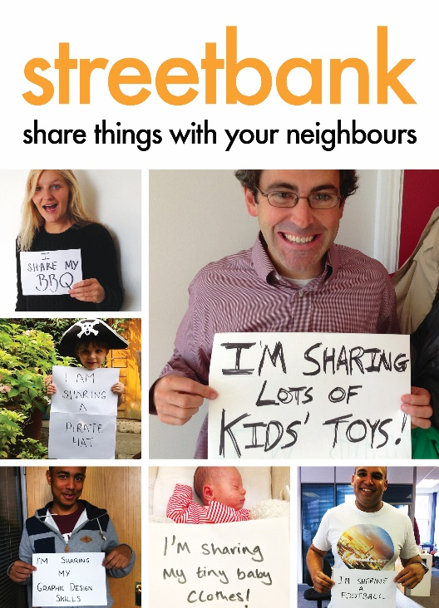
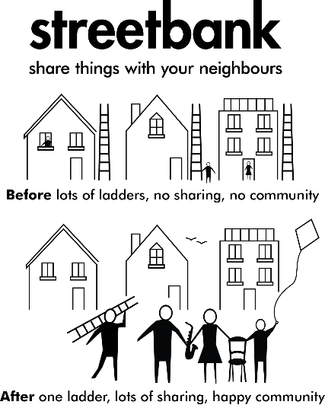
Streetbank
What is it? What does it do?
As we’ve grown materially richer we’ve become more self-reliant and less well connected. We no longer need our neighbours, and sometimes we don’t even know our neighbours. Streetbank is a website that connects neighbours who want to share and borrow things. It’s also a place to give away unwanted things and share skills. It’s not a sales website, or a place for professionals to promote their services. The act of freely giving (and receiving) promotes friendlier, more supportive neighbourhoods. Neighbours who’ve never previously spoken make connections.
Not only does the site help strengthen the local community, it makes economic sense (how many ladders does one street need?) and environmental sense – infrequently used items (hedge trimmers, etc.) get shared around and unwanted things don’t get thrown away.
In a nutshell: friendlier neighbourhoods, money saved and less stuff ending up in landfill.
It acts at a very local level as members each have a unique 1 mile catchment area. A weekly newsletter lists new members, offers, wants and local announcements.
All that’s required for membership is to offer one thing – a book, a DVD, some gardening equipment, etc. There’s no fee to sign up.
How does it work and how is it funded?
Streetbank is a London-based charity founded in 2010 by Sam Stephens.
In February 2014, Streetbank merged with Freeconomy to become the “go to” website for neighbourhood sharing and its membership currently stands at over 50,000, with users in countries all over the world.
It’s supported by Nesta’s Innovation in Giving Fund and is building a base of regular donors from its membership to fund improvements to the mobile app and to further grow its membership.
For more information: www.streetbank.com
What does it achieve?
Promotes community spirit
Encourages generosity and volunteerism
Promotes greener living – reusing things
Reduces carbon footprint – local needs are met by local solutions
Reduces poverty - lowers consumption
Removes perceived barriers to asking for help

Slide 28
Our Design Principles
The following Design Principles are based on our research and experience of working in the communities thus far, conversations with key stakeholders and mentoring sessions with Asset Based Community Development experts.
Our Design Principles will inspire our service design process and we will go back to them several times during the design and implementation of the service idea to make sure that we are true to what we learned working in the community and what the residents told us.
Our Resilient Together Service is
Accessible: to any resident with a desire to contribute to their community. Special care will be taken to make it accessible to people with low literacy and whose primary language isn’t English.
Grounded: in what matters to the community (meaningful and relevant) and therefore builds the community from the bottom up.
  Holistic: as it promotes the community as a whole, rather than a select group of individuals.
Sustainable: as it is easy to implement and facilitate.
Innovative: doesn’t duplicate what’s previously been created (especially not what’s already available in the community).
Scalable as it is relevant to a national audience.
“(…) we can disable people as professionals. The most powerful (thing to do) to disable somebody is to tell them that we’re helping them and to tell ourselves that we’re helping them and to do the helping by wearing the mask of love.”
Asset Based Community Development Expert

Slide 29
Conclusions
The research has shown that a healthy community means a place where people feel connected, where they feel that they know where to turn if they need help, and that they are welcomed and are part of something.
The people we spoke to told us that they wanted to make their lives better, and that the community space has a key role to play in this.
“I would not know where to turn for help, and this is worrying me”
We learned that a sense of purpose, a social network and personal contacts are really important to people to help them feel positive, calm their anxieties and feel in control.
“Barriers are in the way for people to be active in their communities”
We learned that there are many people in the communities who are willing to do more and be active, but that they need some support and encouragement in order to do that. Sometimes barriers to engagement are there that can’t be surmounted (like the lack of transport or a language barrier), but many times barriers are not just physical but they are in our minds too. These barriers take the shape of anxiety and fear of failing, the feeling of insecurity that we have nothing to give.
“Participation is something you can learn”
But we have also learnt that everyone has something to give. What’s needed is to create and identify opportunities for giving, in a protected and supported way. Participation is something that can be learned, everyone can participate, if they choose to, and benefit from doing so. The hardest thing to learn, sometimes, is to let people helping you. We have heard the stories of some people that do so much in their community and that this is rewarding, but that this can be tiring too. Everyone at times needs some rest and some help, and it is important to learn how to balance the giving with the receiving, so people don’t burnout. As one of the resident told us, people think that their problems are too small to ask for help.
The gap in the service
We have also learnt that there is a clear gap in provision of information of what support and resources are available in the community, and that many people, especially new residents, don’t know where to go and what is available to them.
Resources and initiatives from the local Council or from local groups need to speak to and be accessible to all the residents, to ensure that everyone can find something for them and everyone has an opportunity to give and take part, if they want to.

Slide 30
Conclusions
Initial Service Ideas
From the work so far we have come up with three initial service ideas that will be tested and developed further in a workshop in April together with members of the councils, residents and organisations fro the two community areas.
Our initial service ideas, based on what we have heard from experts, residents and other key stakeholders are:
1) Community Booster Toolkit
This is a resident-led community building model that trains a subset of residents to become Community/Conversation Champions, provisioning them with a toolkit of easy-to-follow and simple resources/printables that enable them to plan community events, and also keep themselves well (e.g. a quick stress barometer whereby the residents rates their stress-levels on a scale, or a weekly planner with reminders of the 5 ways to wellbeing). The tools will be built in a visual and engaging way to be used to reflect and plan things for the individual and for the community alike. We will provide tools that help the community to draw on their existing resources (like Asset mapping tools) but also to imagine completely different ideal scenarios and unleash the community creativity (like future scenarios, horizon scanning inspirations, and more).
Further resources could be made available that aid and encourage community building behaviours (e.g. Free branded tea-bags: Come for a Cuppa! and other tools for conversation boosting). This resource could be available online too and built in a way that makes it expandable.
Step by step of the service
Becoming aware: A subset of the residents is initially identified and invited to be part of the service
Wanting to engage: People will have the opportunity to meet other people from the same community and will be provided with new skills and resources that will be transferable, and could be used in future jobs and career development too.
Being able to engage: People can choose between an online and off-line flexible training offer
Sustaining engagement: The toolkit will be introduces with an interactive and practical training. People will learn about how to use the tool by working on organising a small initiative in there area, They will work in pairs and will have the opportunity to use and test the tools and also to improve the resources by adapting existing tools or providing new ones.
Exit: Once they have completed their training and celebrated by organising their first event, the whole community will be involved and everyone attending the final events will be able to get a copy of the toolkit and start planning what next to organise in the community.

Slide 31
Conclusions
2) Community circles
This service idea explores the opportunity to develop a programme of recruitment, training and support to become Community Champion of a ‘resilient community’ and set up a Community circle. As one of the expert in ABCD approach that we interviewed said ” When it comes to the wellbeing of a community, it is the health of the group that matters most and not the capacity of the leader.”
With this in mind, our Community circles build on the strength of the group and operate as convenors and facilitators of the brilliant things that are already happening in the community. They are made of people from all walks of life that can welcome new residents and people that never engaged in the community before. The people that are part of the Circle are confident in starting a conversation with new people in the area, and sharing their stories and their gifts. But they also know when to ask for help and how important is to take care of yourself, in order to take care of the others in the Circle.
To rewards these people for playing this role in the community innovative systems (like for example Community coin) will be explored.
Step by step of the service
Becoming aware: the service will be promoted to active members of the communities that have already engaged with the Resilient Together project and new people will be contacted through community groups, churches and other promotional events (flyers, meetings, etc)
Wanting to engage: People trust other people in the community and decide they want to share their experience and reflect on how they could do more together with others, while taking care of themselves
Being able to engage: A Community Circle is given a budget they can apply for, if they choose to be part of the programme and to set up the peer-to-peer community group.
Sustaining engagement: The Circle is peer led and has resources that it can decide how to invest. Each Circle is assigned a facilitator, which at the beginning will be somebody from Mind in Cambridgeshire, and the facilitator role will be to make sure the Circle is working in collaborative ways, will provide content, signposting and moderation, if needed. The Circle will provide people with their own space and resources to reflect together on why community engagement is important, how they can build more engagement with volunteers and they will also develop personal tools and coping mechanisms to take care of their mental wellbeing and improve their resilience. The Circle will be self-sustaining for a maximum period of 6 months during which they will have to invest their money in training for them and in events for the community. After the first round the Circle will have to explore innovative avenues for raising more funds (e.g. crowdfunding or community coins).
Exit: At the end of the 6 months the Circle decide how to keep going and will look autonomously into possibilities for extra funding. Mind in Cambridgeshire staff will provide advice on this level. Ideally the group will become a spin-off for another Community Circle to start next.

Slide 32
Conclusions
3) Reclaim the Streets
Based on some of the learning from Streets Alive and Connect&Do, this idea explores how we can build a service that helps residents in the two local areas and groups to organise events and parties, such as picnics, tea parties, green initiatives and street play to build communities from the street up.
As we have heard from the research with the residents people feel that they want to inhabit their communities and their streets and establish new ways to reclaiming their local space. These groups can have an online dimension too, like in the Connect&Do example, that can be accessed only by residents and that is available as a shared space for information, support and ideas 24h.
This service idea will give people opportunities to meet others in an informal settings and to establish those local connections that can be vital, if you are in need of help and to increase the feeling of belonging and of security.
Step by step of the service
Becoming aware: There is no better way to launch this service then organising a street party! People will get to know about the opportunities and the steps needed to organise one themselves by being invited to join the first street party in the area
Wanting to engage: People will have a good time at the street party, they will meet other people that live on their area, and also people that have organised street parties before.
Being able to engage: People leave their contact details at the end of the party and they can join the next community event that will be organised in the area or become part of the organising group for the next street party or community initiative. The Council may possibly support the initiative by providing a simple and streamlined approach to book the streets for the parties
Sustaining engagement: There will be commitment and resources to organise at least 5 of these streets events or gardening initiatives in each local area for 1 year. People will have multiple opportunities to take part, get to know other people, increase their connections and their self confidence so they can join again and also help organise the next event, when it’s time. Different people will have the opportunity to both have a role just joining but also organising a community event. Everyone will bring to the group what they can share (their skills, passions, local food, a place to organise the activities, ideas for new things to do) and everyone will get something back by increasing their feeling of community in the local area and getting to knock on people’s doors and to know their neighbours.
Exit: The first group that does organise the first event sets up a Facebook page or online group to share the step by step of how to organise a street party and they will recruit at least 5 people each that can come up with ideas and share resources for the next event to be organised.

